Slide 1
ASSERT TRACK PROJECT
By
Jayanth Venkata Sai Sanampudi (samanpudij@mail.sacredheart.edu)
Renuka Devi Mangalkuntla (mangalkuntlar@mail.sacredheart.edu)
Under the Guidance of Professor “Nikshep Ashok Kulli”

Slide 2
INTRODUCTION
Asset Track is a software tool designed to keep track of valuable items or assets within an organization. It helps businesses or individuals manage their assets efficiently by providing features like recording asset details, such as add, view, delete and save assigning ownership to specific users, and tracking changes in asset status over time. Asset Track aims to streamline asset management processes, reduce the risk of loss or misplacement, and ensure better utilization of resources. By automating tasks such as asset identification, tracking, and reporting, Asset Track contributes to improved organization, increased accountability, and ultimately, better decision-making.

Slide 3
OBJECTIVES
Develop a framework for automated assertion generation that analyzes code semantics, execution paths, and data flows to identify potential failure points and invariants.
Integrate assertion generation seamlessly into the software development lifecycle, supporting popular programming languages and development environments.
Implement techniques for assertion validation and monitoring to ensure that assertions remain accurate and effective over time.
Evaluate the effectiveness of Assert Track through comprehensive testing, benchmarking against existing assertion techniques, and real-world case studies.

Slide 4
MAIN FUNCTIONS
addAsset(vector<Asset>& assets): Prompts the user to input details of a new asset and adds it to the vector of assets.
viewAssets(const vector<Asset>& assets): Displays a formatted table of all assets in the vector.
markAssetOutOfStock(vector<Asset>& assets): Allows the user to mark an asset as out of stock.
deleteAsset(vector<Asset>& assets): Deletes an asset from the vector based on the user's input index.
saveAssetsToFile(const vector<Asset>& assets, const string& filename): Saves the asset data to a file in CSV format.
loadAssetsFromFile(vector<Asset>& assets, const string& filename): Loads asset data from a CSV file into the vector.

Slide 5
Saving the output to txt file
Initializes a vector of assets and a filename for data storage.
Loads assets from the file into the vector.
Displays a menu for user interaction, allowing them to add, view, mark as out of stock, delete, save, or exit.
Each menu option corresponds to a function call to perform the desired action.
int main() { vector<Asset> assets;
string filename = "assets.txt";
loadAssetsFromFile(assets, filename);

Slide 6
CODE https://github.com/jayanthSanampudi/final-project/pull/1

Slide 7
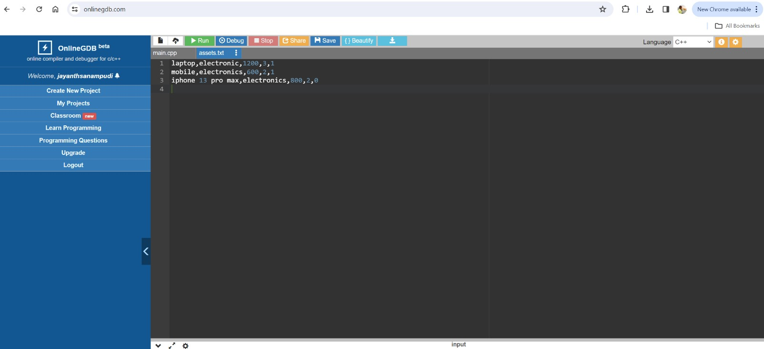
SOURCE DATA

Slide 8
CONCLUSION
Assert Track represents a significant advancement in the field of software reliability, offering a comprehensive solution for automating assertion generation and management. By empowering developers with tools to enhance code quality and reliability, Assert Track aims to foster a culture of proactive error prevention and continuous improvement within the software development community.

Slide 9
THANK YOU

